Slide 1
Training centre
Education & Training Department

Slide 2
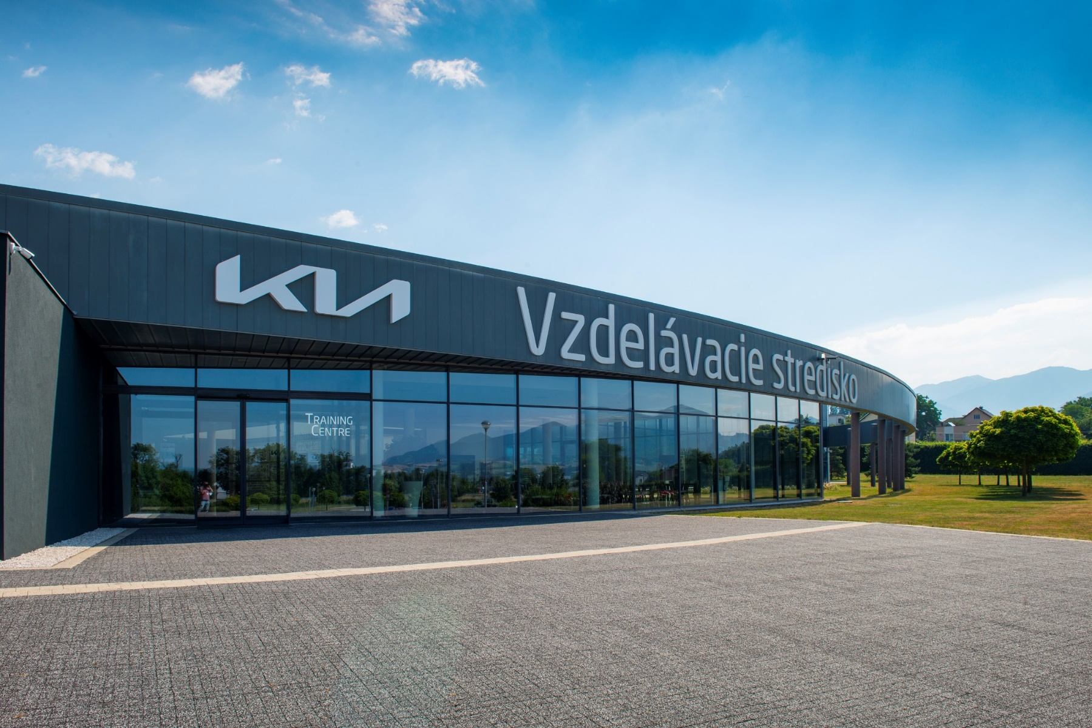
Training Centre

Slide 3
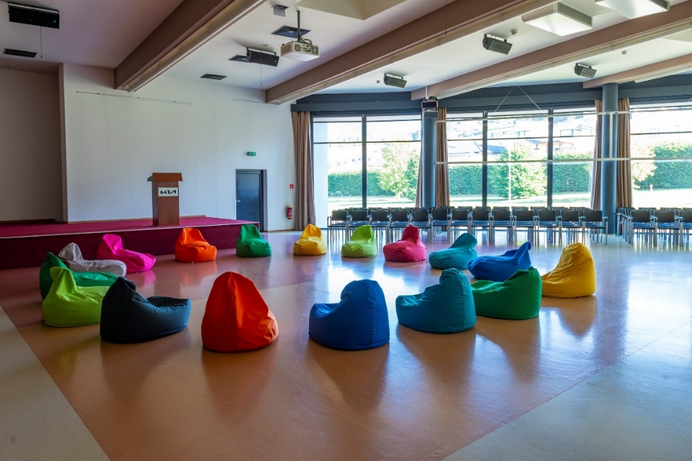
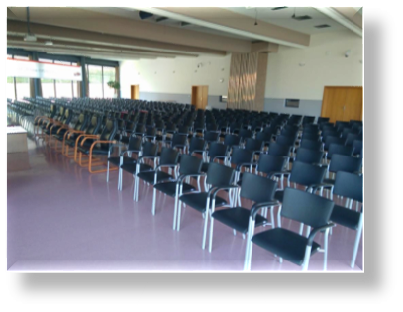
Auditorium
Additional information:
Auditorium is controlled from a separate room (Director´s room)
Area - 570 m2
There are 2 connection points on the stage (LAN, HDMI, VGA, audio, 230V), Wi-Fi
Capacity: 500 (only chairs) or 160 (with tables)
Equipment: | Remark:
Meeting chair (500 pcs) | Black or white
Speech Desk (2 pcs) | 2 pcs with integrated microphone
VIP chairs (10 pcs)
Projector (3 pcs) | All projectors are independent Resolution: “1280:800“ Diagonal Aspect Ratio: “16:10“
Wireless microphone (4 pcs) | 3 pcs – hand 1 pcs - headset
Meeting table (48 pcs) | Folding legs with casters

Slide 4
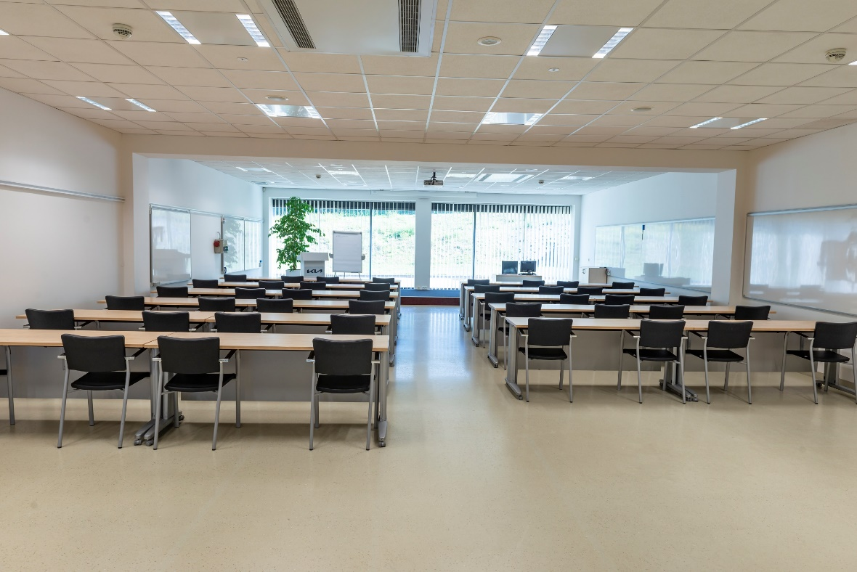
Lecture Room No. 101
Purpose of use:
Seminars
Courses
Events
Lectures
Trainings
Job interview
Additional information:
Capacity - 44 persons
Area - 156 m2
Available speech desk, flipchart stands, plasma TV, dress rack
Equipment | Remark
Office desk (22 pcs) | 600*1800 on casters
Meeting chair (44 pcs) | Black or white
Lector desk with PC & chair | connections: LAN, HDMI, audio, VGA, 230V socket, Wi-Fi
Projector | with electric screen Resolution: “1280:800“ Diagonal Aspect Ratio: “16:10“
Wireless microphone (2 pcs) | 1 pc – hand 1 pc - headset
White board (8 pcs) | 5 pcs – movable on the wall 2 pcs – fixed on the wall 1 pc – with casters
Socket 400V and 230V | Fixed on the wall
Supply port for compressed air | Fixed on the wall

Slide 5
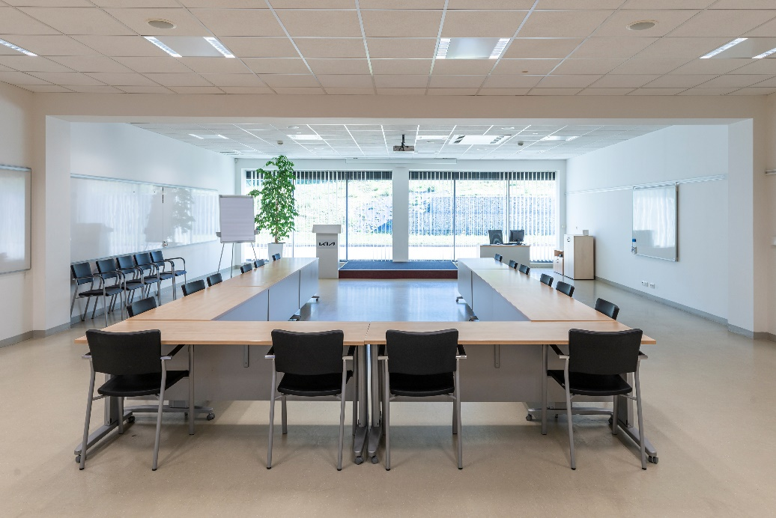
Equipment | Remark
Office desk (22 pcs) | 600*1800 on casters
Meeting chair (44 pcs) | Black or white
Lector desk with PC & chair | connections: LAN, HDMI, audio, VGA, 230V socket, Wi-Fi
Projector | With electric screen Resolution: “1280:800“ Diagonal Aspect Ratio: “16:10“
Wireless microphone (2 pcs) | 1 pc – hand 1 pc - headset
White board (5 pcs) | 2 pcs – movable on the wall 2 pcs – fixed on the wall 1 pc – with casters
Socket 400V and 230V | Fixed on the wall
Lecture Room
No. 102
Purpose of use:
Seminars
Courses
Events
Lectures
Trainings
Job interview
Additional information:
Capacity - 44 persons
Area - 157 m2
Available speech desk, flipchart stands, plasma TV, podium, dress rack

Slide 6
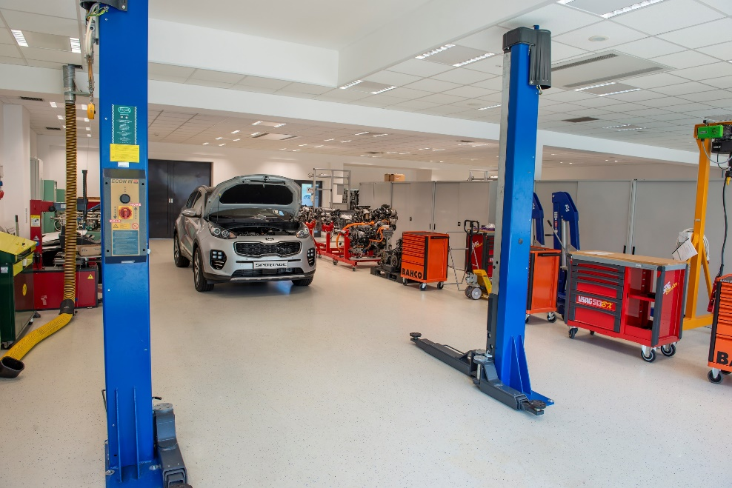
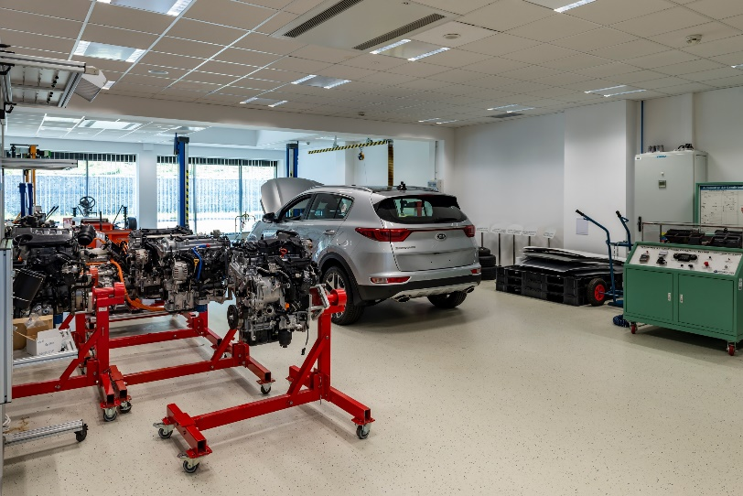
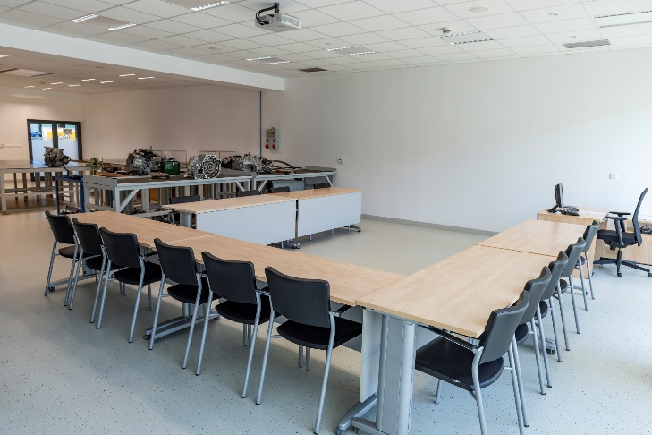
Lecture Room No. 103
Equipment | Remark
Office desk (6 pcs) | 600*1800 on casters
Meeting chair (12 pcs) | Black or white
Lector desk with PC & chair | connections: LAN, HDMI, audio, VGA, 230V socket, Wi-Fi
Projector (1 pc) | With fixed screen on the wall Resolution: “1280:800“ Diagonal Aspect Ratio: “16:10“
Wireless microphone (2 pcs) | 1 pc – hand 1 pc – headset
Car repair equipment | Car lifts, tire changer, wheel balancer, tools, ...
Workshop equipment | welding machines, grinder, hacksaw, ...
Socket 400V and 230V (4 pcs) | Fixed on the wall
Supply port for compressed air (2 pcs) | Fixed on the wall
Additional information:
Capacity - 12 persons
Area – 309 m2
Available flipchart stands, plasma TV, training kits (ABS, ACC, car electronic scheme), engine simulators
Purpose of use:
KaSk trainings
Repair of cars
Final exams
Special trainings

Slide 7
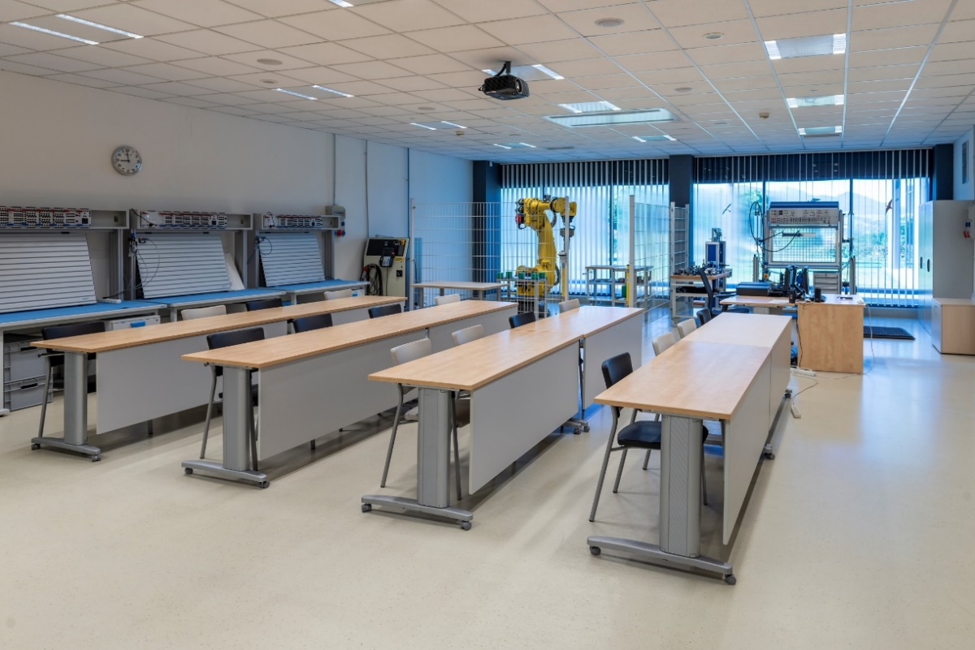
Lecture Room No. 105
Equipment | Remark
Office desk (17 pcs) | 600*1800 on casters
Meeting chair (32 pcs) | Black or white
Lector desk with PC & chair | connections: LAN, audio, VGA, 230V socket, Wi-Fi
Projector | with electric screen Resolution: “1024:768“ Diagonal Aspect Ratio: “16:9“
Microphone | 1 pc – hand
White board (4 pcs) | 2 pcs – movable on the wall 2 pcs – with casters
Socket 400V and 230V (4 pcs) | Fixed on the wall
Supply port for compressed air (2 pcs) | Fixed on the wall
Hydraulic and Pneumatic devices | Training kit, working desk, …
Purpose of use:
Pneumatics and hydraulics trainings
Special trainings
Additional information:
Capacity - 32 persons
Area – 145 m2
Available flipchart stands, plasma TV

Slide 8
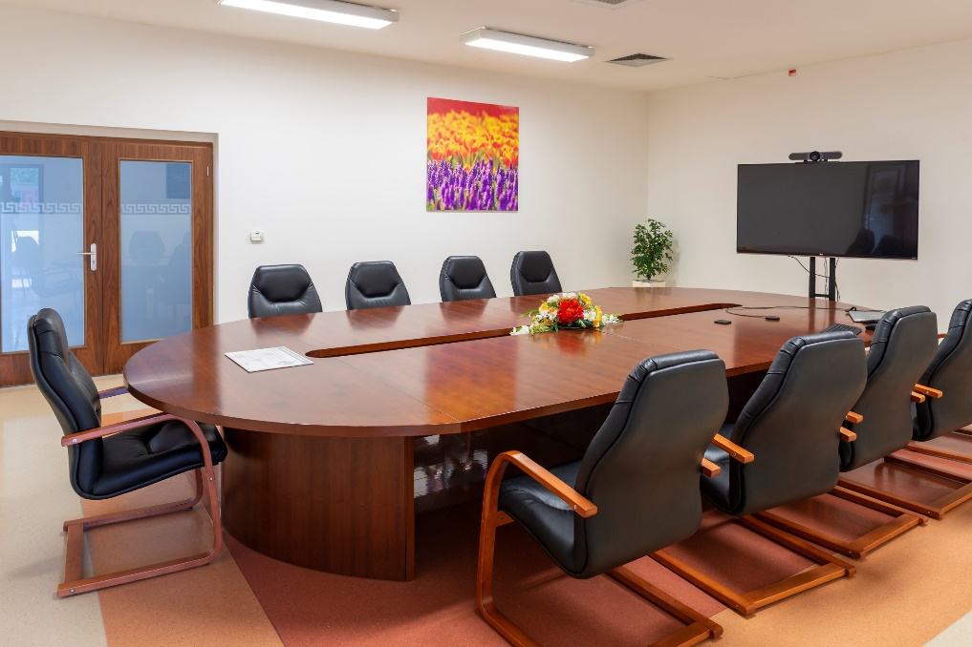
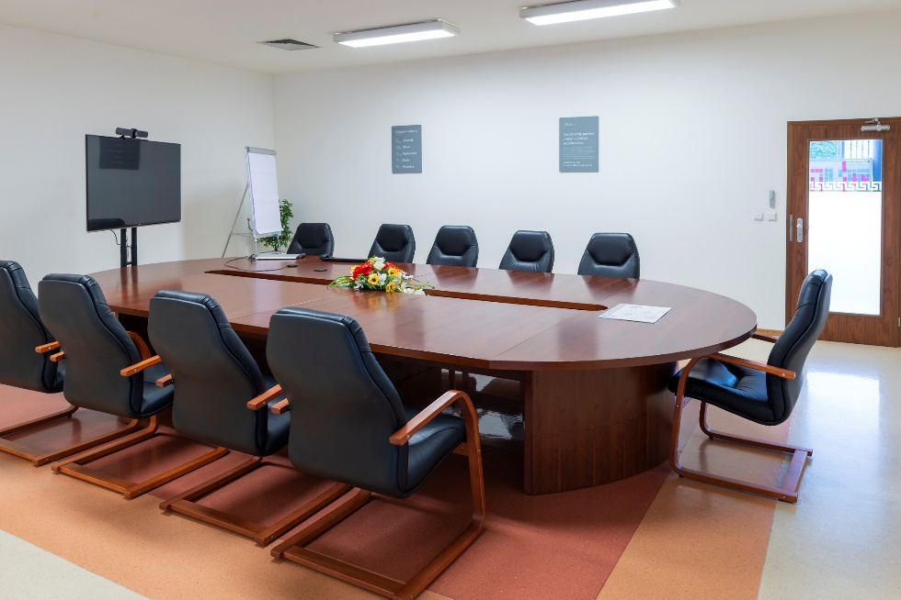
Lecture Room No. 124
Equipment:
  VIP table – 1 pc (250*650)
  VIP chair – 10 pcs
  Projector – 1 pc
  Resolution: 1024:768
  Diagonal Aspect Ratio: 4:3
Additional information:
  Capacity - 10 persons
  Area – 50 m2
  Fixed screen on the the wall, flipchart stands, plasma TV, Wi-Fi
Purpose of use:
  Meetings
  VIP visits
  Conferences

Slide 9
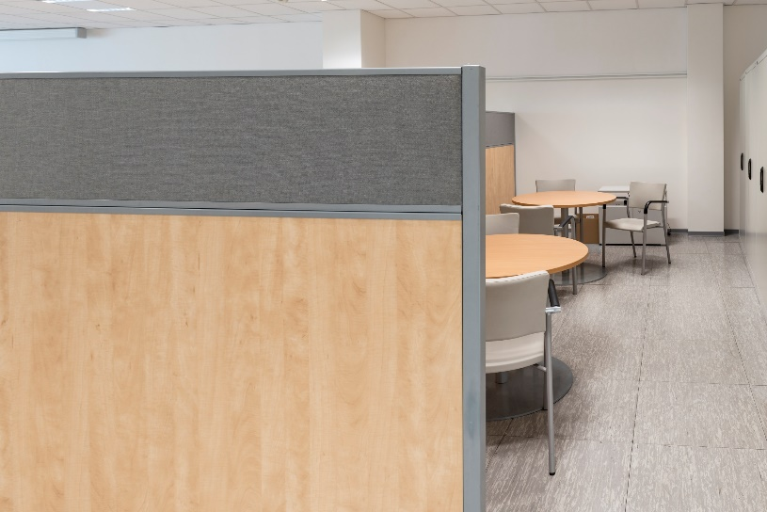
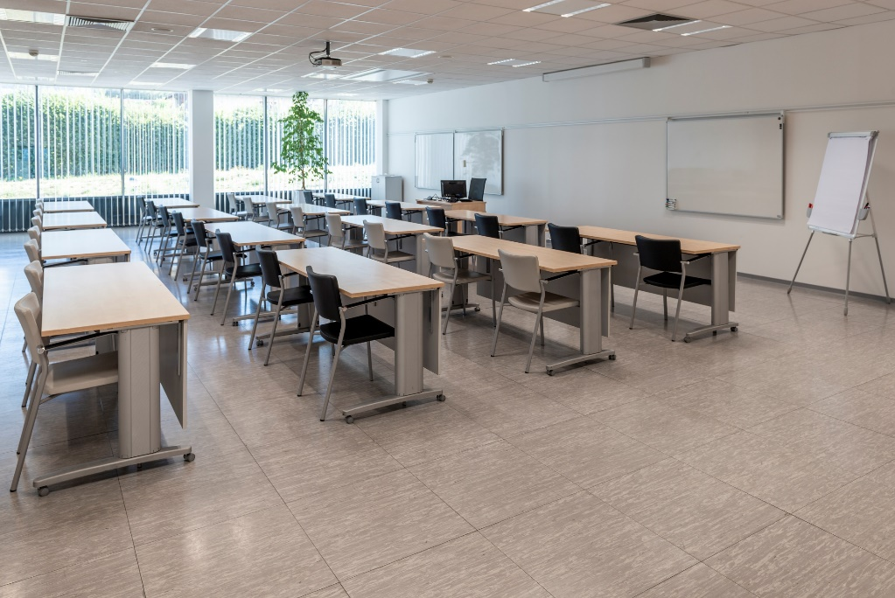
Equipment | Remark
Office desk (16 pcs) | 600*1800 on casters
Meeting chair (32 pcs) | Black or white
Lector desk with PC & chair | connections: LAN, HDMI, audio, VGA, 230Vsocket, Wi-Fi
Projector | With electric screen Resolution: “1024:768“ Diagonal Aspect Ratio: “16:9“
Microphone wireless | 1pc - hand
White board (5 pcs) | 3 pcs – movable on the wall 1 pc – fixed on the wall 1 pc – with casters
Socket 400V and 230V | 1pcs - fixed on the wall
Small rest area | 2 pcs - round table 6 pcs - meeting chair
Lecture Room
no. 201
Purpose of use:
Seminars
Courses
Events
Lectures
Trainings
Job interview
Additional information:
Capacity - 32 persons
Area – 158 m2
Available flipchart stands, plasma TV, dress rack

Slide 10
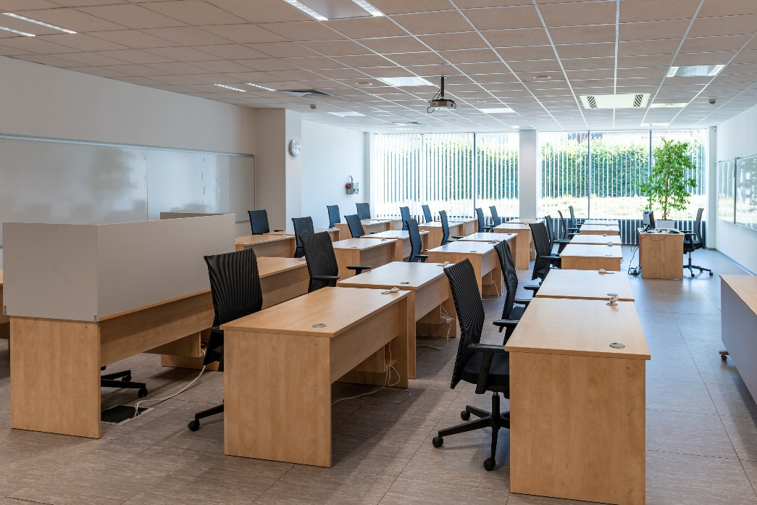
Lecture Room No. 202
Equipment | Remark
Office desk with office chair (24 pcs) | Desk with PC
Lector desk with PC & chair | Connections: LAN, audio, VGA, 230V socket, Wi-Fi
Projector | With electric screen Resolution: “1024:768“ Diagonal Aspect Ratio: “4:3“
Microphone wireless | 1pc – hand
White board (6 pcs) | 4 pcs – movable on the wall 1 pc – fixed on the wall 1 pc – with casters
Socket 400V and 230V (1 pc) | Fixed on the wall
Small rest area | 2 pcs - round table 6 pcs - meeting chair
Additional information:
Capacity - 24 persons
Area – 160 m2
Available flipchart stands, plasma TV, dress rack
Purpose of use:
PC Courses
Job interview
Special PC courses

Slide 11
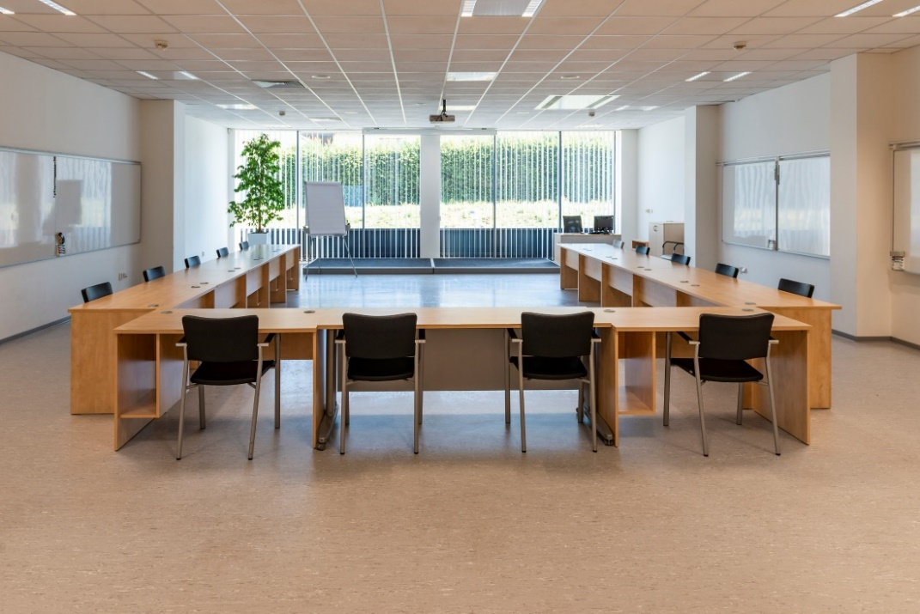
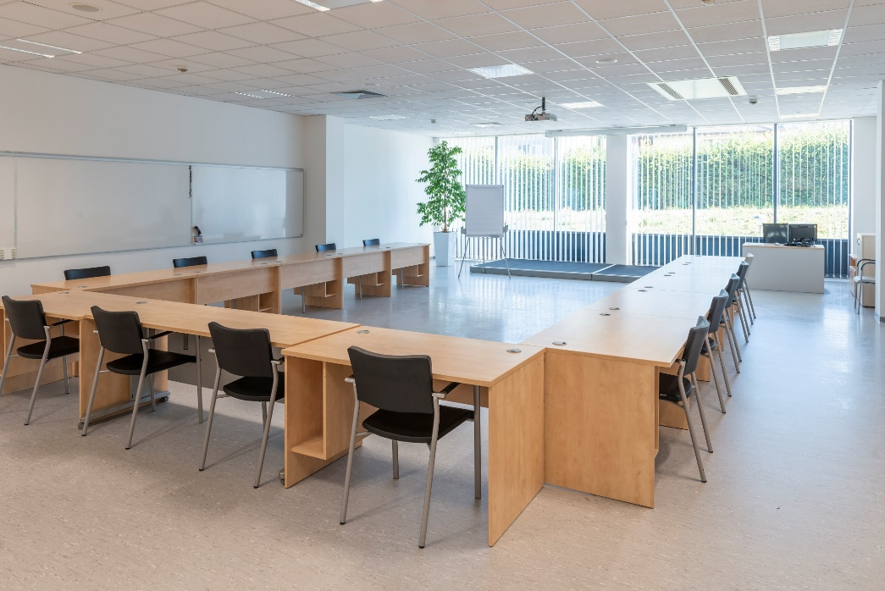
Lecture Room No. 203
Equipment | Remark
Office desk with office chair (17 pcs) | 700*1200
Lector desk with PC & chair | Projectors: LAN, HDMI, audio, VGA, 230Vsocket,Wi-fi
Projektor | With electric screen Resolution: “1280:800“ Diagonal Aspect Ratio: “16:10“
Microphone wireless (2 pcs) | 1 pc – hand 1 pc – headset
White board (6 pcs) | 4 pcs – movable on the wall 1 pc – fixed on the wall 1 pc – with casters
Socket 400V and 230V (1 pc) | Fixed on the wall
Additional information:
Capacity - 17 persons
Area – 157 m2
Available flipchart stands, plasma TV, dress rack
Purpose of use:
Trainings
Meetings
Lectures
Events
Job interview

Slide 12
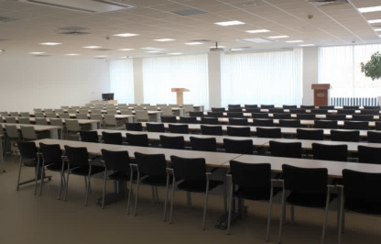
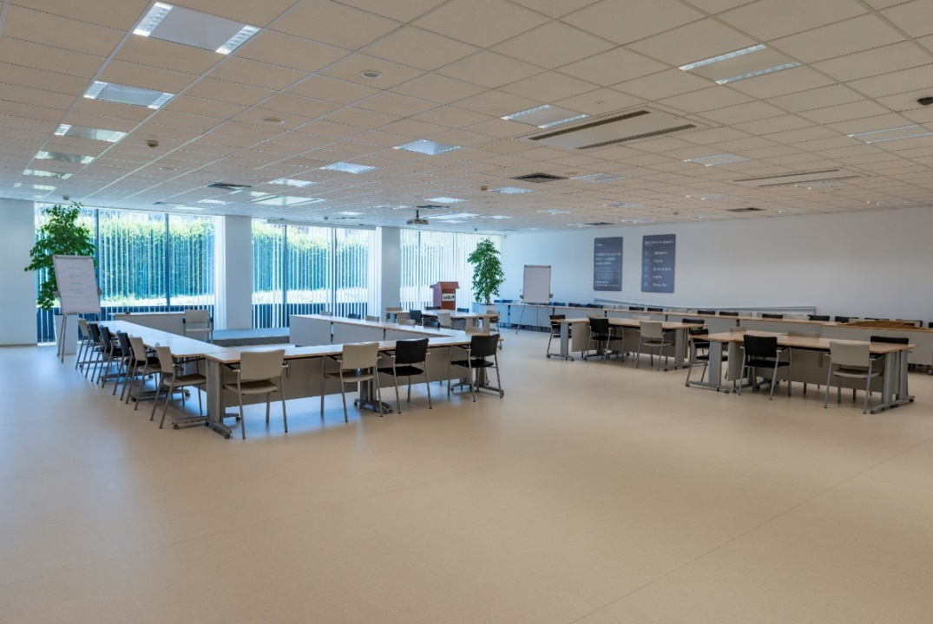
Equipment | Remark
Office desk (42 pcs) | 600*1800 on casters
Lector desk with PC & chair | connections: LAN, HDMI, audio, VGA, 230Vsocket, Wi-Fi
Projector | With electric screen Resolution: “1280:800“ Diagonal Aspect Ratio: “16:10“
Microphone wireless (3 pcs) | 2 pcs – hand 1 pc - headset
Speech Desk (2 pcs) | with KIA logo
Lecture Room
No. 204
Additional information:
Capacity - 126 persons
Area – 266 m2
Room is controlled from touchpad LCD panel (located in lector desk)
Available flipchart stands, plasma TV, movable white board, dress rack
Purpose of use:
Conferences
Trainings
Events
Seminars
Lectures
Meetings
Job interview
School visits

Slide 13
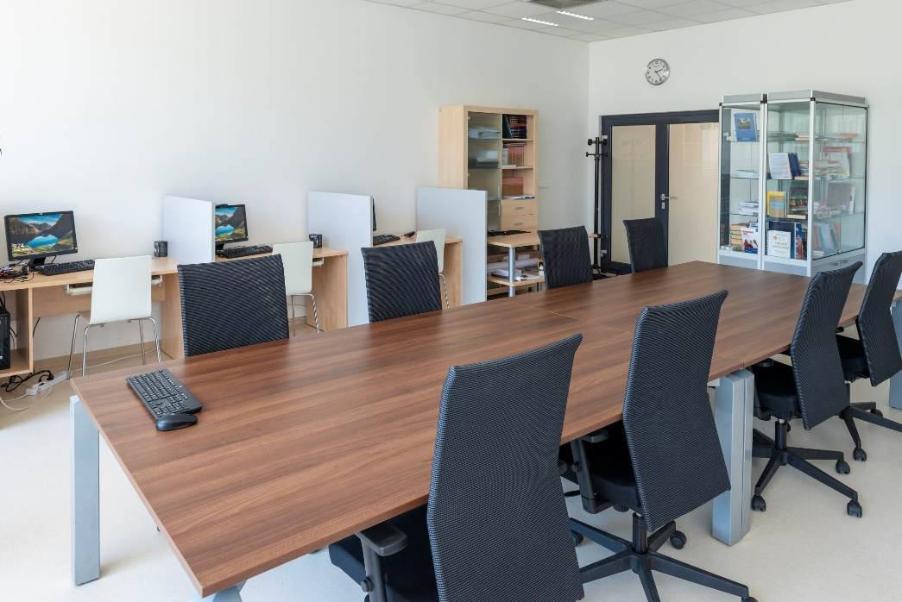
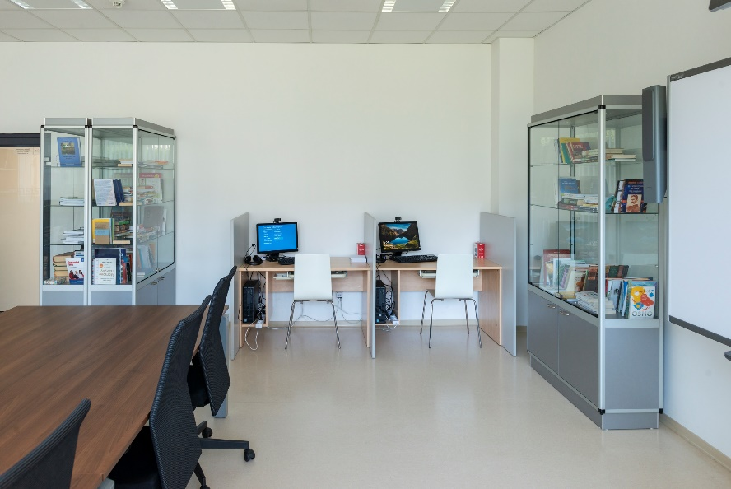
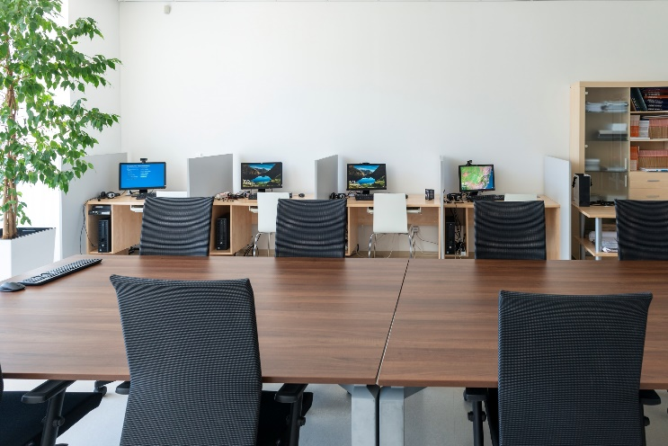
Lecture Room No. 205
Equipment | Remark
Office desk with chair (7 pcs) | Desks with PC
Lector desk with PC & chair | connections: LAN, HDMI, audio, VGA, 230Vsocket, Wi-Fi
Meeting table (2 pcs)
Office chair (8 pcs)
Smart board with projector and speaker | Resolution: “4000:4000“ Diagonal Aspect Ratio: “16:10“
White board (1 pc) | Movable with casters
Additional information:
Capacity - 8 persons
Area – 57 m2
Available flipchart stands, plasma TV, interactive smart board, dress rack
Purpose of use:
Small meetings
Internet room
Visits
Job interview

Slide 14
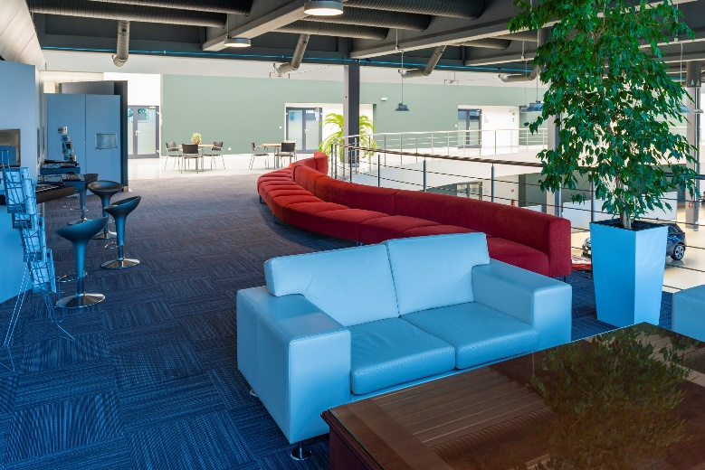
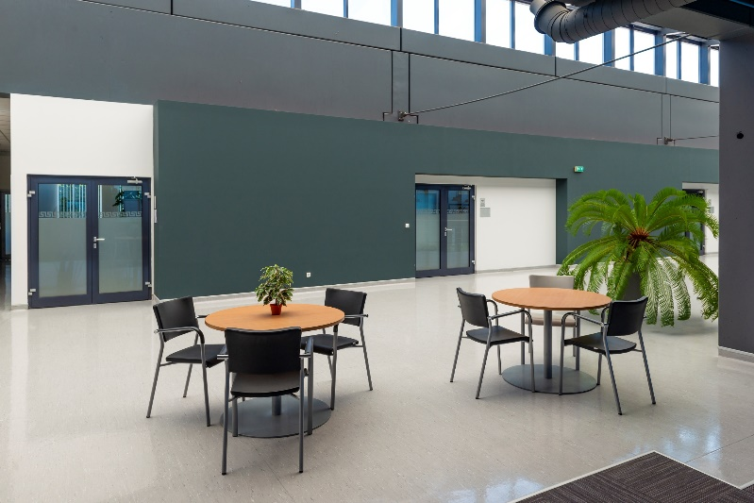
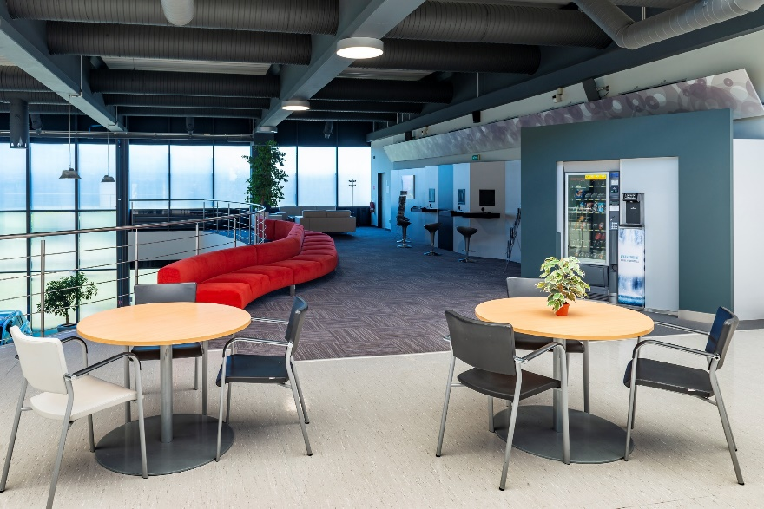
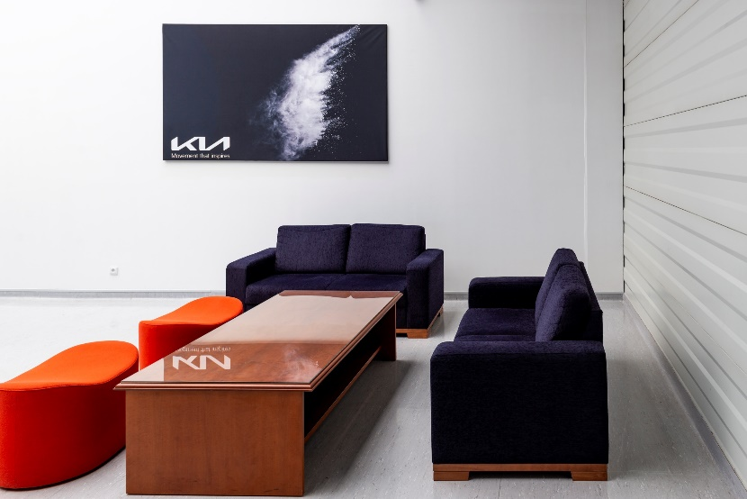
Rest area upstairs
Equipment:
  Sofa - 5 pcs
  Water box – 2 pcs
  Food and drink machines – 1 pc
  Fixed desktop computer – 4 pcs
Purpose of use:
  Rest area
  Internet
Additional information:
  Capacity - 19 persons

Slide 15
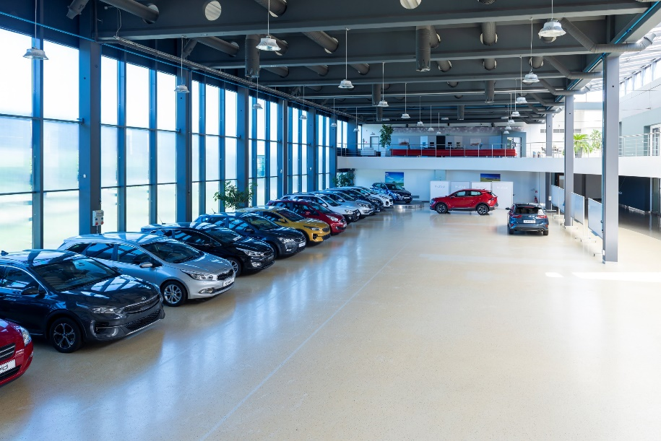
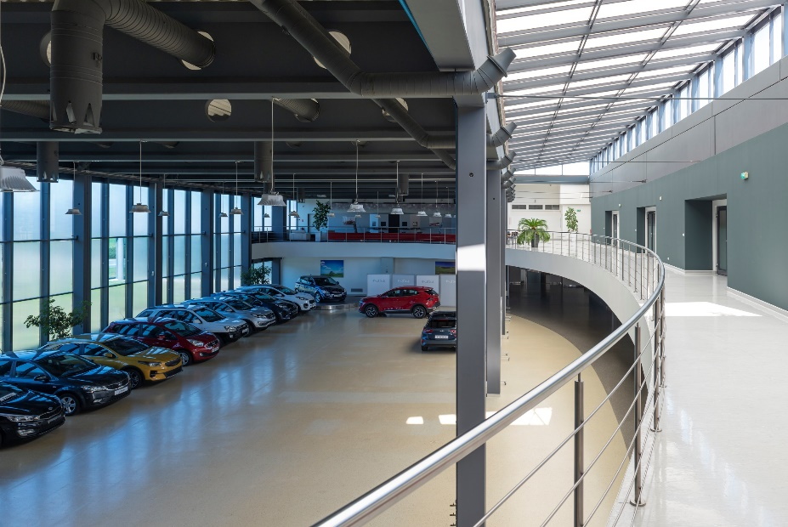
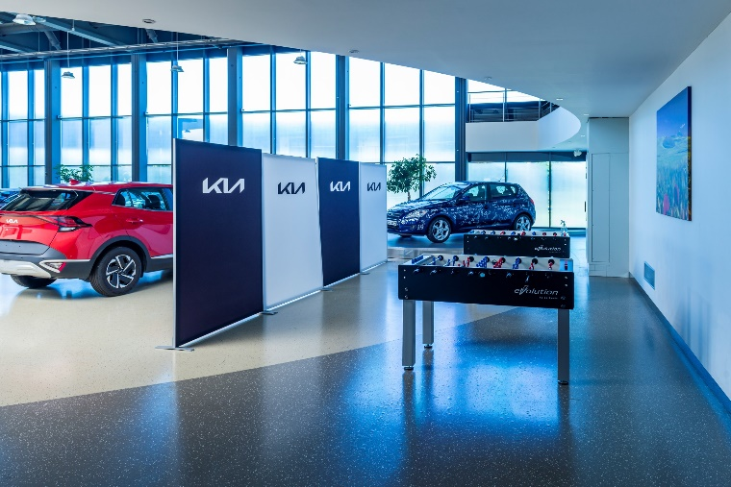
Equipment:
Socket 400V – 10 pcs fixed on the wall
Socket 230V – 22 pcs fixed on the wall
Supply port for compressed air - 9 pcs fixed
on the wall
Sliding entrance gate (for cars)
KIA cars:
Venga I. generation – 1 pc
Cee´d I. generation – 1 pc
I. generation (facelift) – 1 pc
II. generation – 3 pcs
Cee´d Sw I. generation – 1 pc
Sportage II. generation – 1 pc
III. generation – 1 pc
Openshop
Purpose of use:
Exposition area
Events
Multipurpose area

Slide 16
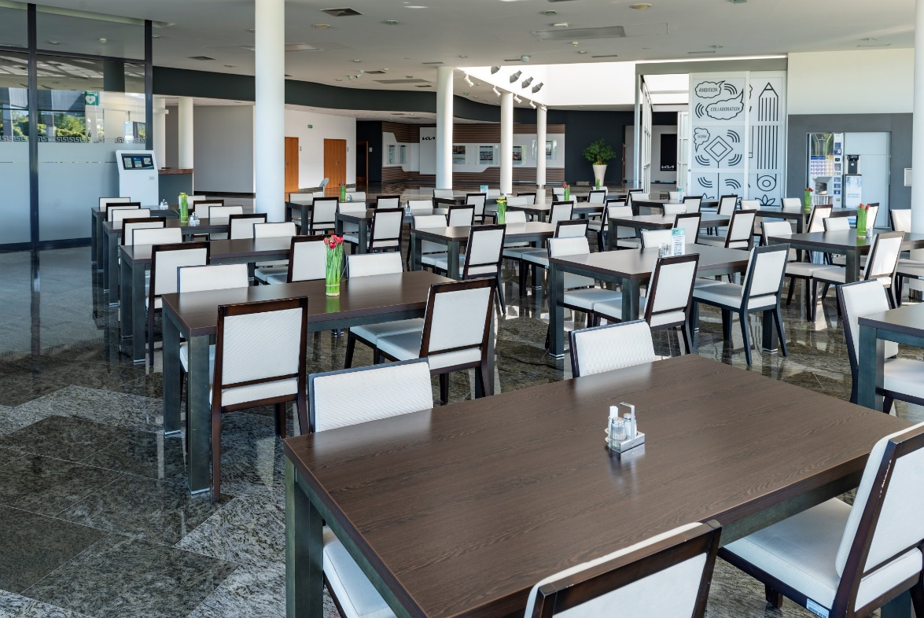
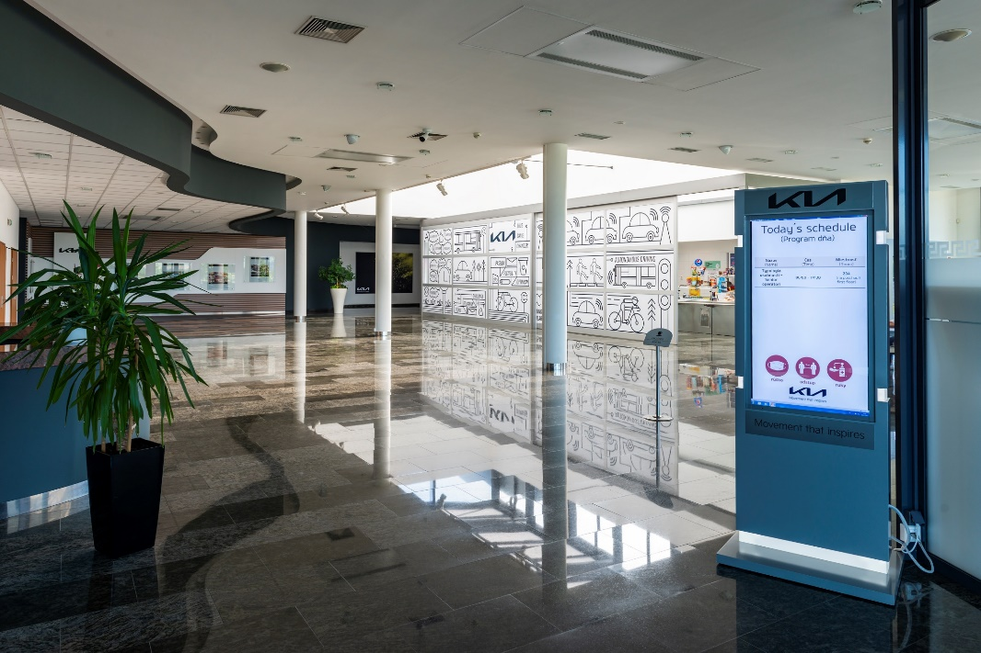
Canteen
Equipment:
  Canteen table - 25 pcs
  Canteen chair – 100 pcs
  Plasma TV – 2 pcs
  Water and Coffee machine – 2 pc
Additional information:
  Capacity - 100 persons
Purpose of use:
  Rest area
  Lunch, dinner
  Events

Slide 17
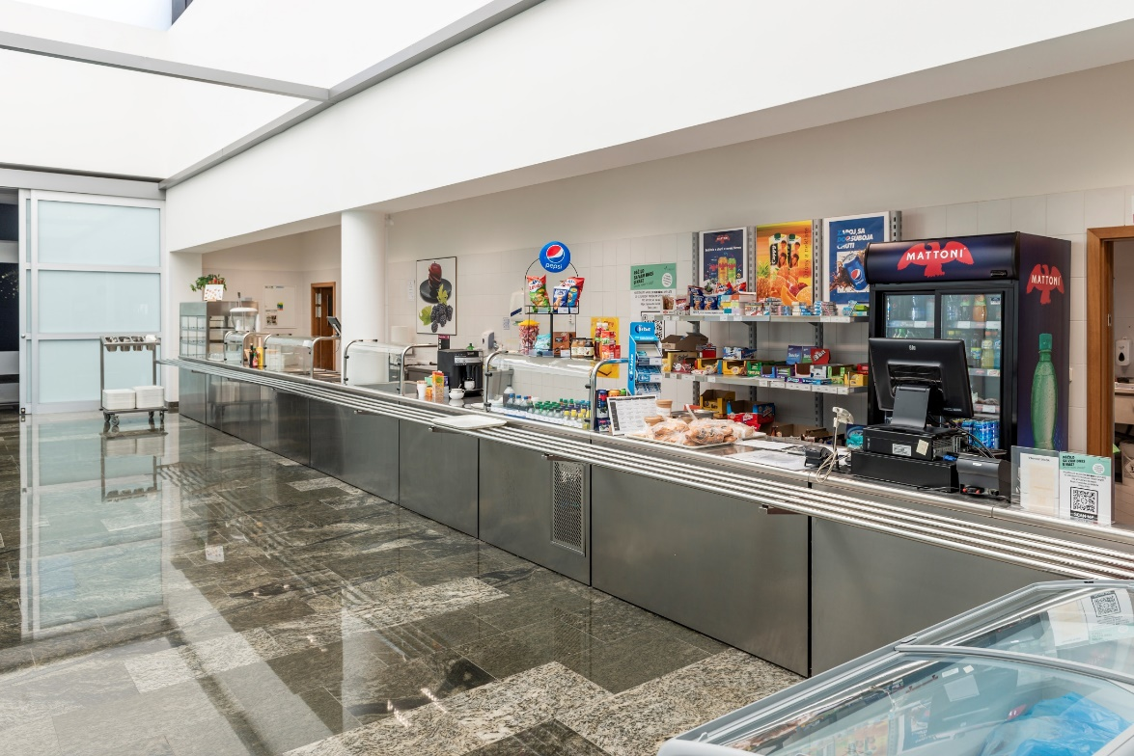
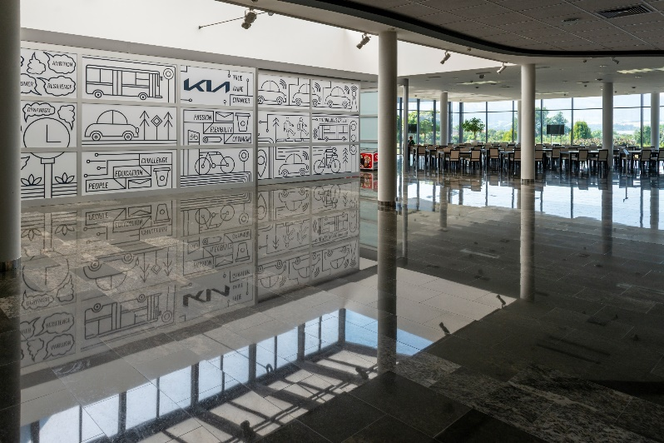
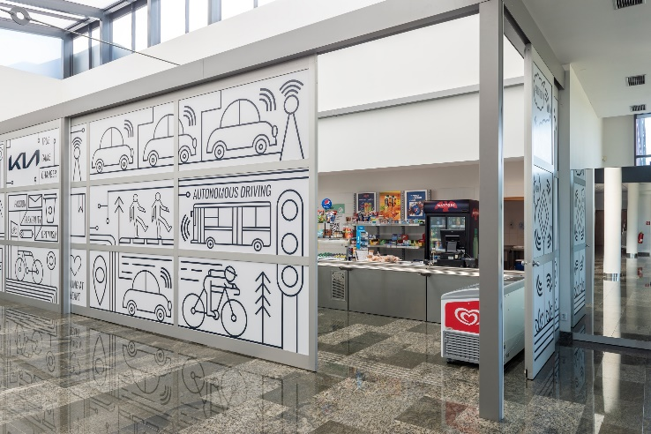
Buffet
Working hours:
  07:00am – 02:00pm
Assortment of goods:
  Non alcoholic drinks
  Pastries in various kinds
  etc.
Offered service (upon request):
  Catering with service
  Lunch
  Dinner
  Refreshments
  Coffee Breaks
Contact:
Compass-Group Slovakia
Phone: 0940 947 022
Email: katarina.plechova@compass-group.sk

Slide 18
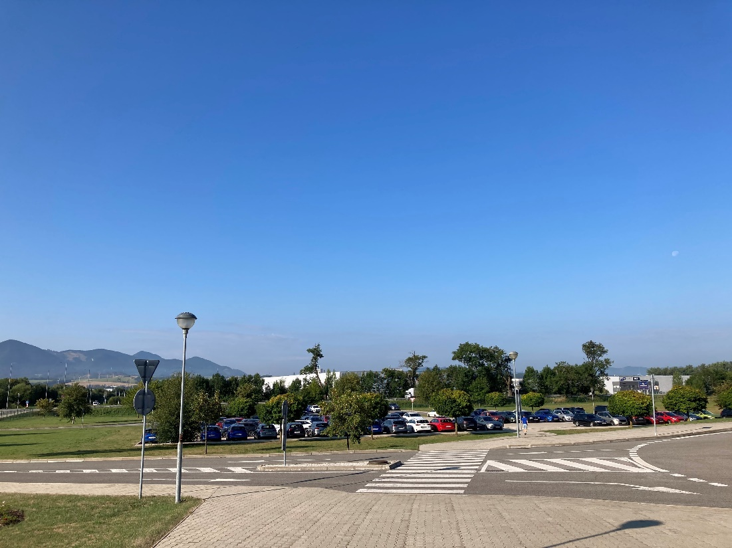
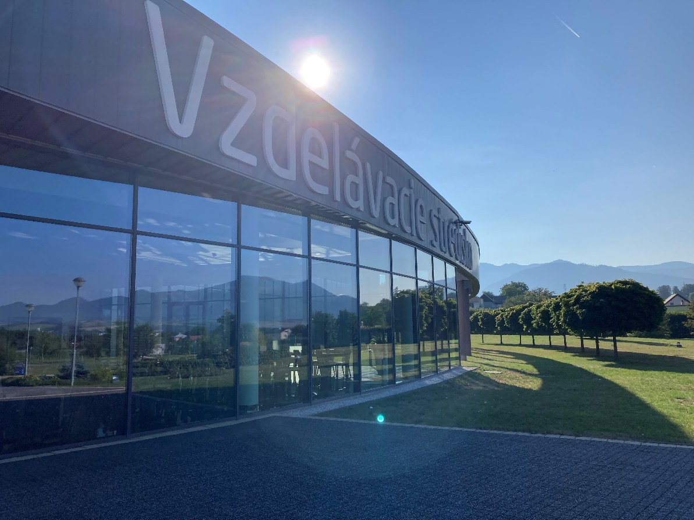
Parking Lot
No. of parking places:
  100 parking places
  Parking for buses
  Guarded parking & all object

Slide 19
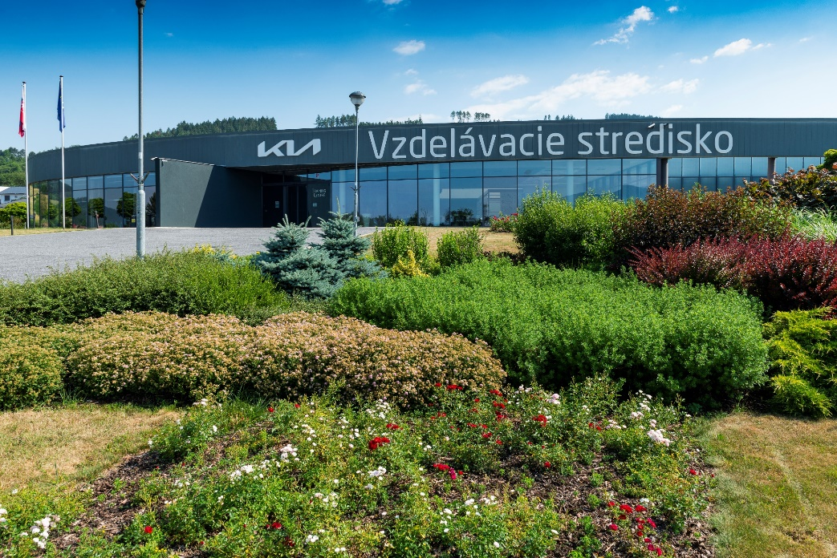
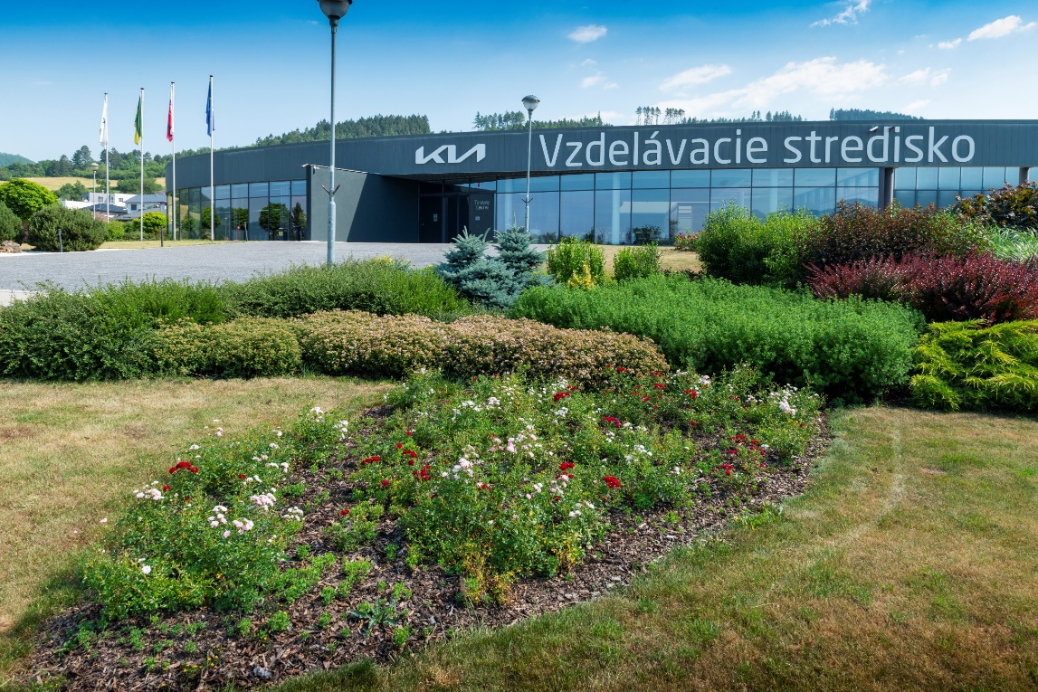
Rental conditions
Basic rental conditions:
  Sending binding order
  Signing lease contract
  Accepting rental condition
Contact information:
Kia Slovakia s.r.o.
Vzdelávacie stredisko
Hlavná 400/1
013 01 Gbeľany
vzdelavanie@kia.sk
+421 41 515 1713

Slide 20


